Slide 1
Contributing Hydro-Addressed data to geoconnex.us and the NLDI
Kyle Onda

Slide 2
Motivation Demo
https://river-runner.geoconnex.us
https://river-runner.geoconnex.us/?lng=-117.04561345492715&lat=46.428272368719746

Slide 3
Outline
What is geoconnex
What is the NLDI
How to contribute to geoconnex.us
How to contribute to the NLDI
How to use your data with the NLDI

Slide 4

Motivations
“As a user of water data, I need to discover and access water information relevant to the environmental feature I care about from all the organizations that hold data about it, so I don’t have to have special knowledge to access some information and so I don’t miss some potentially relevant information.”
A water-specific search index that links data to geographic features like streams, watersheds, aquifers, and administrative boundaries
A free, open-source software suite that lets data providers automate the process of ingesting data, standardizing data, serving through an API, and serving relevant metadata
Guidance and basic data extraction tools that make it easier for users to access data from already existing hubs, such as Water Quality Portal
Dave Blodgett (USGS)
Second Environmental Linked Features Experiment: (https://docs.ogc.org/per/20-067.html
Notes:
Where does geoconnex come from. Basically it comes out of the intenrnational Stream of work at the open geospatial Consortium (the OGC) called the itneroperability experiments. Dave Blodgett from USGS had a leadership role in these experiments, the lessons of which form the core ideas behind geoconnex, and I work directly with him on this project. He also expressed the general motivating user story. “As a user of water data, I need to discover and access water information relevant to the environmental feature I care about from ALL organizations that hold data bout it, so I dont’ve have to have special knowledge to access osme information and so I don’t miss some potentially relevant information. Meaning basically, I want all the data but I don’t want to have to know where all that data lives ahead of time.

Slide 5
Motivations
How can we quickly aggregate hydrologic relationships between features that are being calculated by numerous scientists and user groups?
“e.g. What discharge locations are upstream, including tributaries, of this water quality sensor?”
How do we maintain the usability of hydrographic dependency graphs over time?
A water-specific search index that links data to geographic features like streams, watersheds, aquifers, and administrative boundaries
A free, open-source software suite that lets data providers automate the process of ingesting data, standardizing data, serving through an API, and serving relevant metadata
Guidance and basic data extraction tools that make it easier for users to access data from already existing hubs, such as Water Quality Portal

Slide 6











Geoconnex – enabling conditions for a knowledge graph of water-related data without centralizing data governance and storage
Notes:
So geoconnex is about creating enabling conditions for maintaining a knowledge graph of water data. SO take this stylized exam[ple of a hydrologic system characterized by two reservoirs connected by a stream with some monitoring locations along it.

Slide 7

Requirement 1: All sites and environmental features should have internet representations (landing pages)
Notes:
Ideally, each environmental feature and sensor should have an internet representation or landing page

Slide 8
Requirement 2: Landing pages should be resolvable by persistent identifiers
https://geoconnex.us/usgs/monitoring-location/3287897
https://waterdata.usgs.gov/monitoring-location/03498850
https://geoconnex.us/nmt/well/223
https://nmt.edu/geoscience/sites/RQ-223
Notes:
Which are directed to by persistent identifiers

Slide 9

Requirement 3: Landing pages should embed structured metadata, including links to data and “reference features”
I am https://geoconnex.us/usace/dam/NM123
I am a Dam
I am the same as the reference dam {https://geoconnex.us/ref/dams/03123}
I impound this Waterbody
I am on this Stream Reach
I am within this HUC8 {https://geoconnex.us/ref/hu08/12345678}
Data on me can be found from this API Call {USACE API call}
Notes:
Those landing pages should include structued-machine readable metadata. For eaxcmple,. A dam might have metadata that standardizes how it describes itself, declaring itself a dam, associated with particular water bodies and streams, and linking out to monitoring data relevant to it.

Slide 10

Requirement 4: There should be a set of neutral, community-curated landing pages for common “reference features” that many organizations publish data about or index data to
Notes:
Finally, siunce many locations might have many different datasets about it from different providers, it is necessary to have persistently identified reference features that multiple data providers can declare that they have resources about. Such features include particular monitoring locations, watersheds, administrative geographies like counties, or pieces of physical infrastructure like dams.

Slide 11
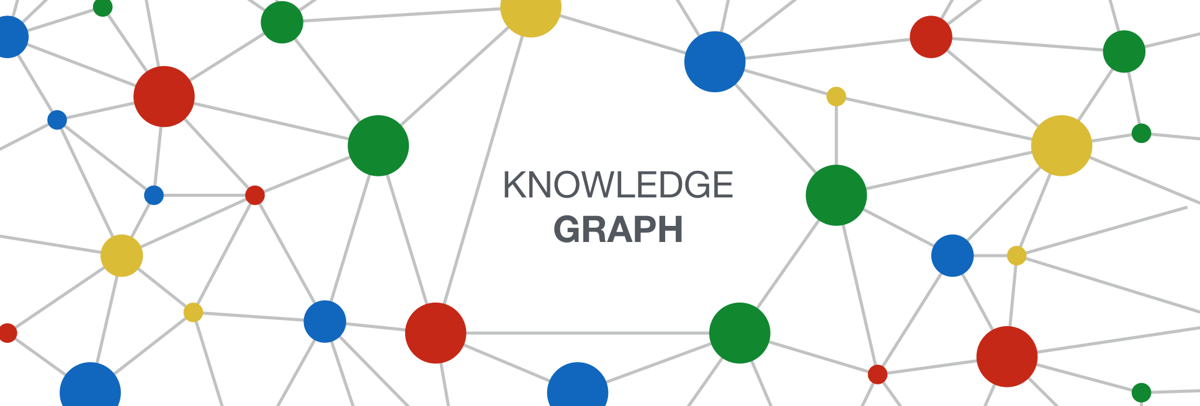
Requirement 5: A web crawler that harvests all landing page metadata and infers the linkages between them
Notes:
Finally, we need a mechanism to tie all of these independent metadata records together. A suitable technology for this is some type of web crawler, which commercial search engines have been using for two decades to do analogous indexing and create tools to discover infromation on the broader world wide web.

Slide 12


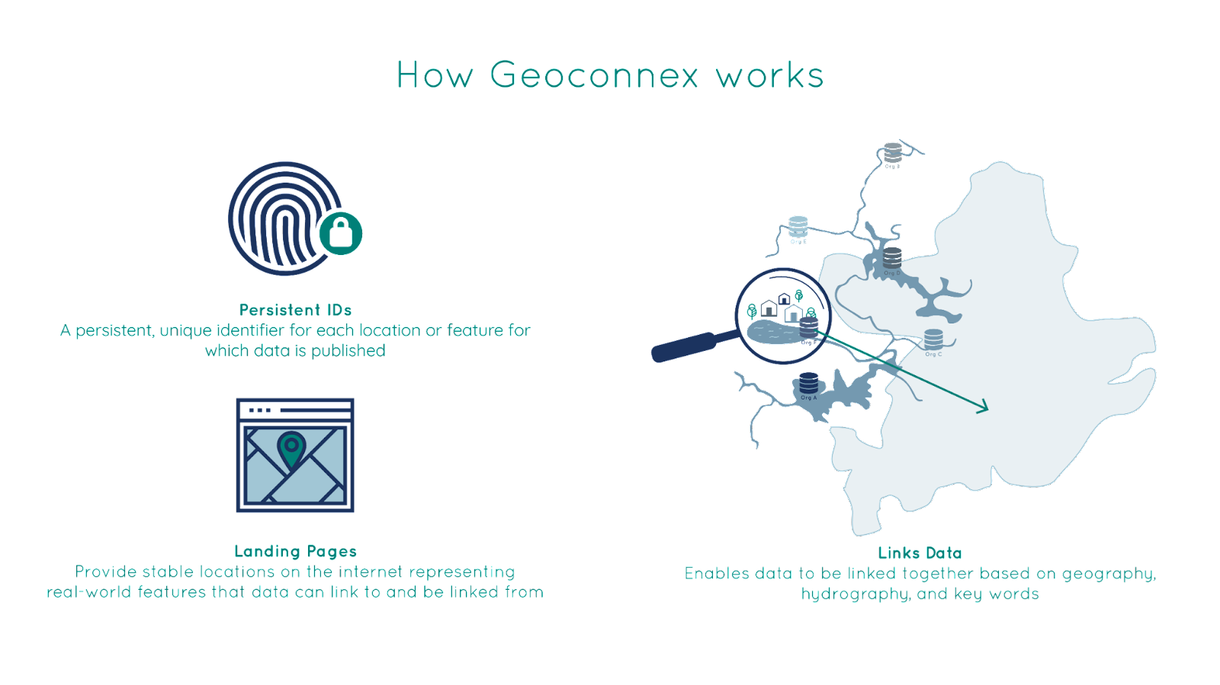



harvest.geoconnex.us
https://geoconnex.us
(persistent identifier registry and resolver)
https://geoconnex.us/sitemap.xml
Reference
features
Triplestore (GraphDB)
GeoSPARQL – based geospatial inferencing
SPARQL – based semantic and hydrologic (upstream/downstream) inferencing
Embedded
JSON-LD
Organizational
Monitoring locations
search.geoconnex.us
graph.geoconnex.us
reference.geoconnex.us
docs.geoconnex.us
JSON-LD guidance, templates, schemas, vocabularies. Derived from SELFIE (HY_Features, schema.org, SOSA/SSN)

Slide 13


Landing page
include
point to
Include links to
Include links to
Observed or Modeled Data
Structured/Linked Data
(JSON-LD)
about
(URL)
(URL)
describe
identify
identify
Hydrologically related
Real-world feature/location of interest
Real-world feature/location of interest

Slide 14







Authoring Guidance
Data user community
Influences
Used By
Influences
Used By
Data Publishers
Indexer
Enables

Slide 15



geoconnex.us Community
Funded By:
Developed by:
Operated by:
Data contributed
(so far) by:

Slide 16
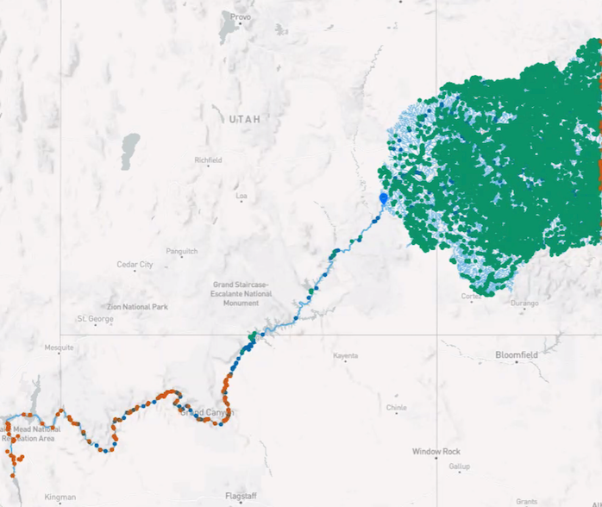
What is the NLDI?
A RESTful application programming interface (API) in front of the NHD (NHDPlusV2 for now, HR support eventually)
An open-source project with the codebase available at https://github.com/internetofwater/nldi-services
Hosted by USGS

Slide 17
How to contribute to geoconnex.us and the NLDI
Hydro-address your location data (see Mike Tinker’s presentation)
geoconnex steps
Publish feature-level landing content with embedded JSON-LD and persistent identifiers
Mint persistent identifiers with https://geoconnex.us
NLDI Steps
Publish a geojson file with your hydro-addressed location data (can be same as step 2)
Register your geojson file with the NLDI repository

Slide 18
1. Hydro Address your data
Use HydroAdd to add NHD Reachcodes and Measures to your locations
Example: https://github.com/internetofwater/gwtc2022-workshop/blob/main/landing_pages/data/data.csv

Slide 19
2. Publish feature-level landing content with embedded JSON-LD and persistent identifiers
Create a persistent identification scheme:
https://geoconnex.us/my-org/topic/.../hierarchy/12345
Examples:
https://geoconnex.us/usgs/monitoring-location/08332622
https://geoconnex.us/epa/hmw/030300020607
stem
namespace
id

Slide 20
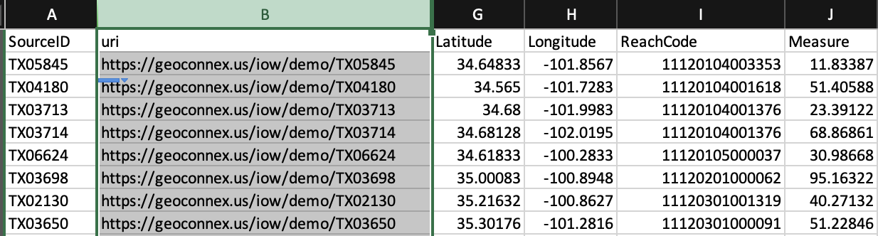
2. Publish feature-level landing content with embedded JSON-LD and persistent identifiers
2. Add the persistent identifiers to your data
Example: https://github.com/internetofwater/gwtc2022-workshop/blob/main/landing_pages/data/data.csv

Slide 21
2. Publish feature-level landing content with embedded JSON-LD and persistent identifiers
3. Publish your data so that each spatial feature has a website with:
a. It’s own URL
b. A human-readable HTML version
c. Machine-readable metadata formatted as JSON-LD
Why?
Search engines can index and organize individual features!
“I want all water quality sample points from all organizations within this random polygon across two counties, but not any others”

Slide 22
2. Publish feature-level landing content with embedded JSON-LD and persistent identifiers
3. Publish your data so that each spatial feature has a website with:
a. It’s own URL
b. A human-readable HTML version
c. metadata formatted as JSON-LD
standardized vocabularies for interoperability with other data
links to common features (like NHD, states/counties/census tracts, etc.)
Example:
https://geoconnex-demo-pages.internetofwater.dev/collections/demo-gpkg/items/ME00227

Slide 23
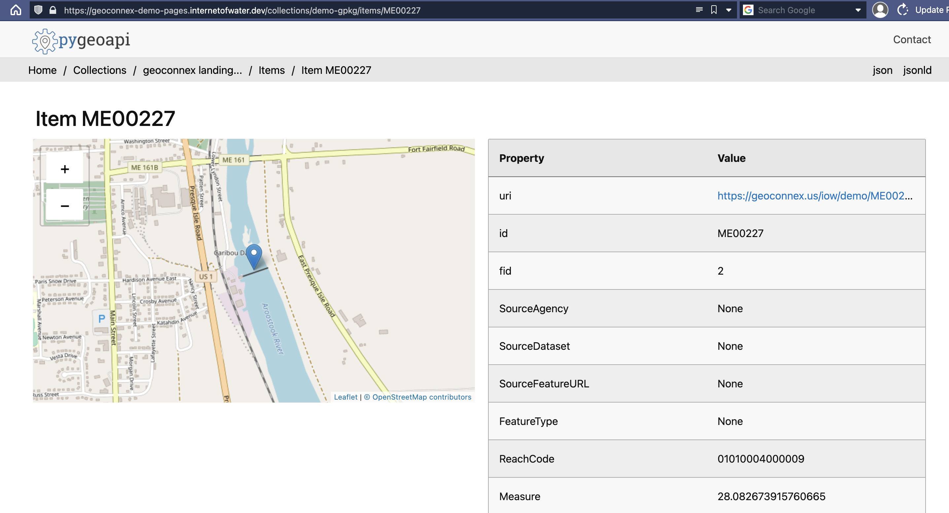

Slide 24
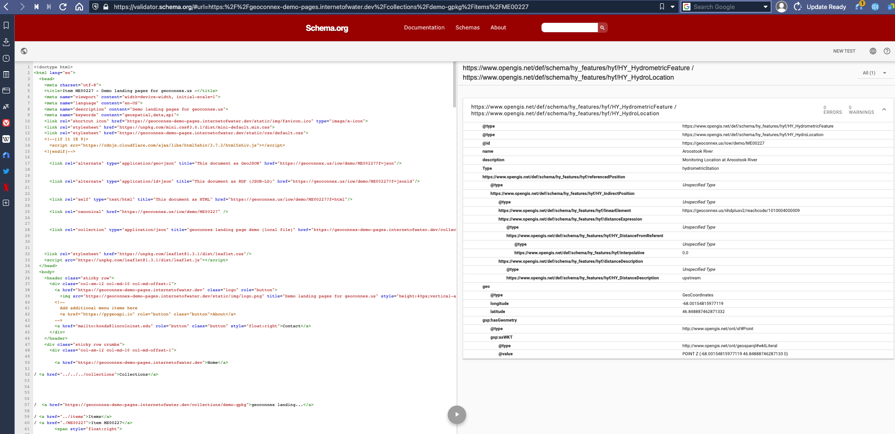

Slide 25
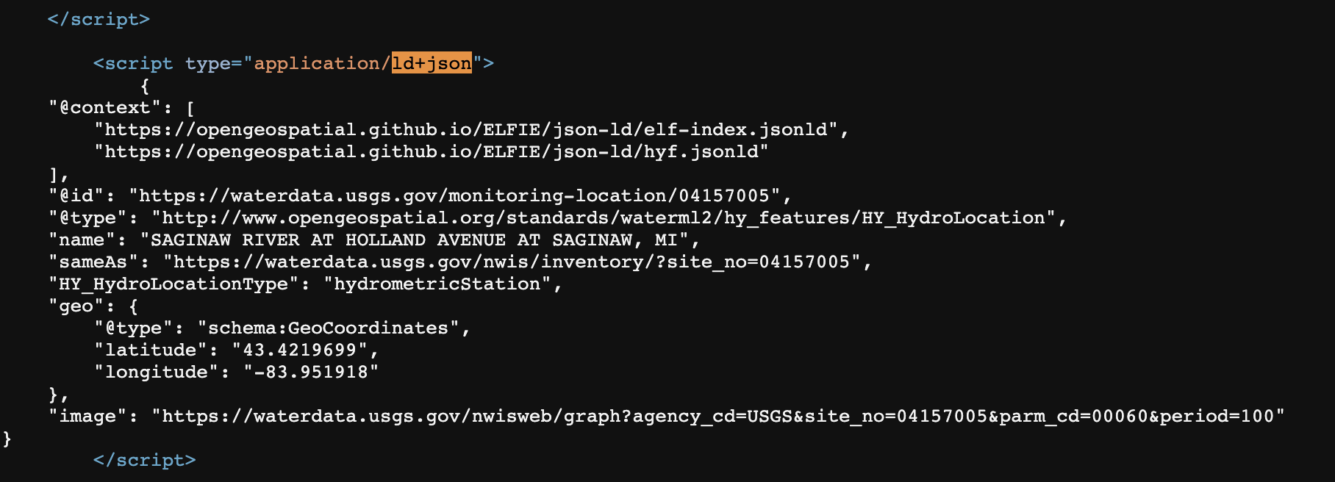
<script type="application/ld+json">
 | {
 | "@context": [
 | "https://opengeospatial.github.io/ELFIE/json-ld/elf-index.jsonld",
 | "https://opengeospatial.github.io/ELFIE/json-ld/hyf.jsonld"
 | ],
 | "@id": "https://waterdata.usgs.gov/monitoring-location/04157005",
 | "@type": "http://www.opengeospatial.org/standards/waterml2/hy_features/HY_HydroLocation",
 | "name": "SAGINAW RIVER AT HOLLAND AVENUE AT SAGINAW, MI",
 | "sameAs": "https://waterdata.usgs.gov/nwis/inventory/?site_no=04157005",
 | "HY_HydroLocationType": "hydrometricStation",
 | "geo": {
 | "@type": "schema:GeoCoordinates",
 | "latitude": "43.4219699",
 | "longitude": "-83.951918"
 | },
 | "image": "https://waterdata.usgs.gov/nwisweb/graph?agency_cd=USGS&site_no=04157005&parm_cd=00060&period=100"
 | }
 | </script>

Slide 26
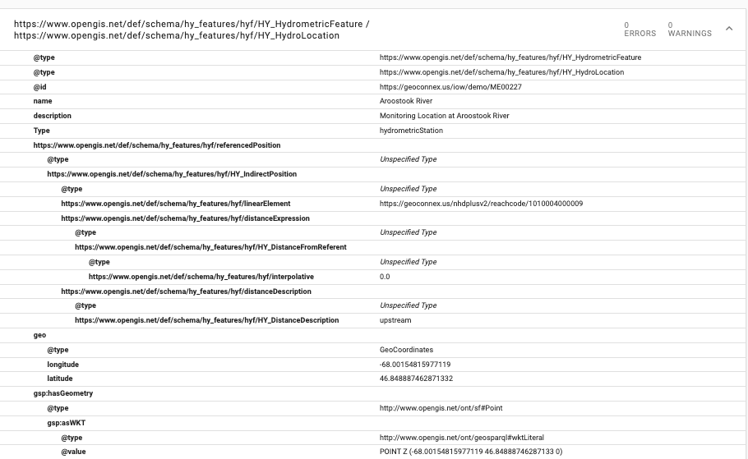

Slide 27
What to put in JSON-LD?
Templates: https://docs.geoconnex.us/participating.html#templates
”@id” : “https://geoconnex.us/iow/demo/TX14456”
“@type”: https://www.opengis.net/def/schema/hy_features/hyf/HY_HydrometricFeature
“https://schema.org/name” : “Site 14556”
“https://schema.org/description” : “Sampling site on Rock Creek near New Hope Bridge”
“https://schema.org/geoWithin”: “https://geoconnex.us/ref/states/48”
"hyf:referencedPosition": [ { "hyf:HY_IndirectPosition": { "hyf:distanceExpression": { "hyf:HY_DistanceFromReferent": { "hyf:interpolative": 35 } }, "hyf:distanceDescription": { "hyf:HY_DistanceDescription": “upstream”}, "hyf:linearElement": ”https://geoconnex.us/nhdplushr/reachcode/121432425”} }

Slide 28
2. Publish feature-level landing content with embedded JSON-LD and persistent identifiers
How?
Templating systems: https://en.wikipedia.org/wiki/Web_template_system
Turnkey solution:
Pygeoapi: https://pygeoapi.io
Internet of Water version: https://github.com/internetofwater/pygeoapi
Docker image: internetofwater/pygeoapi:stable
Can generate landing pages and JSON-LD from:
csv, geojson, shp, geopackage/SQLite
PostGIS
OGC WFS
ESRI FeatureServer/MapServer
https://geoconnex-demo-pages.internetofwater.dev/collections

Slide 29
3. Mint persistent identifiers with https://geoconnex.us
Like a URL shortener, for your features!
https://geoconnex.us/your-org/123 -> 303 redirect ->
https://yourorg.com/sites/123
or
https://yourorg-newwebsite.com/api?site=123
or …

Slide 30
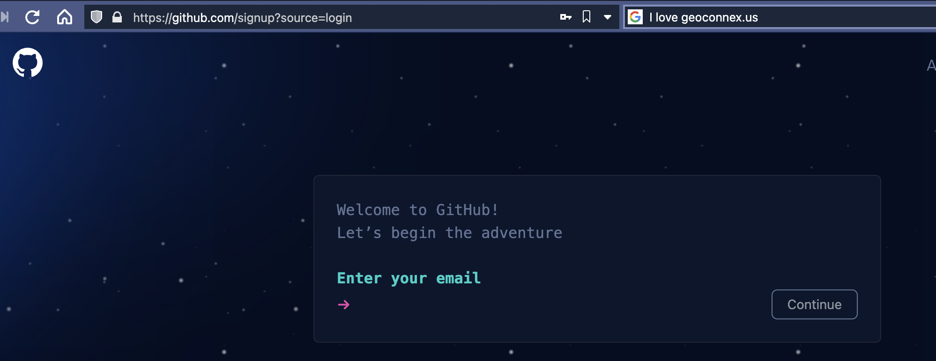
3. Mint persistent identifiers with https://geoconnex.us
Step 0: Create a Github account

Slide 31
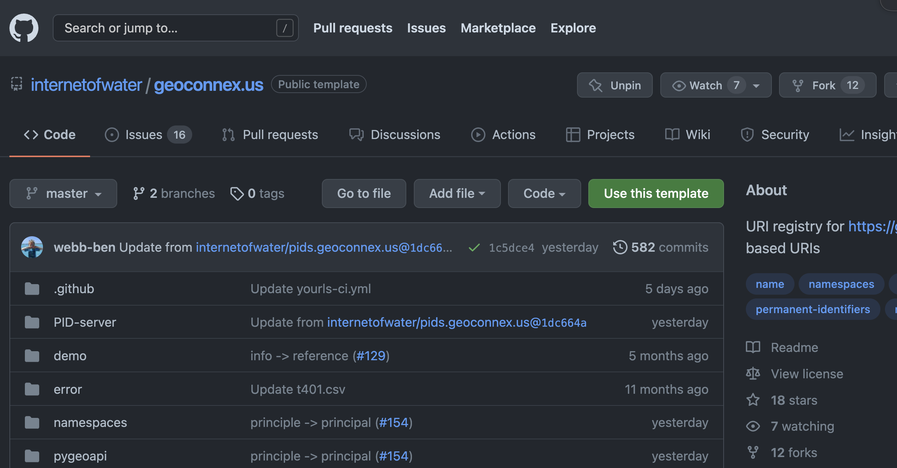
3. Mint persistent identifiers with https://geoconnex.us
Step 1: Fork the repository: https://github.com/internetofwater/geoconnex.us

Slide 32
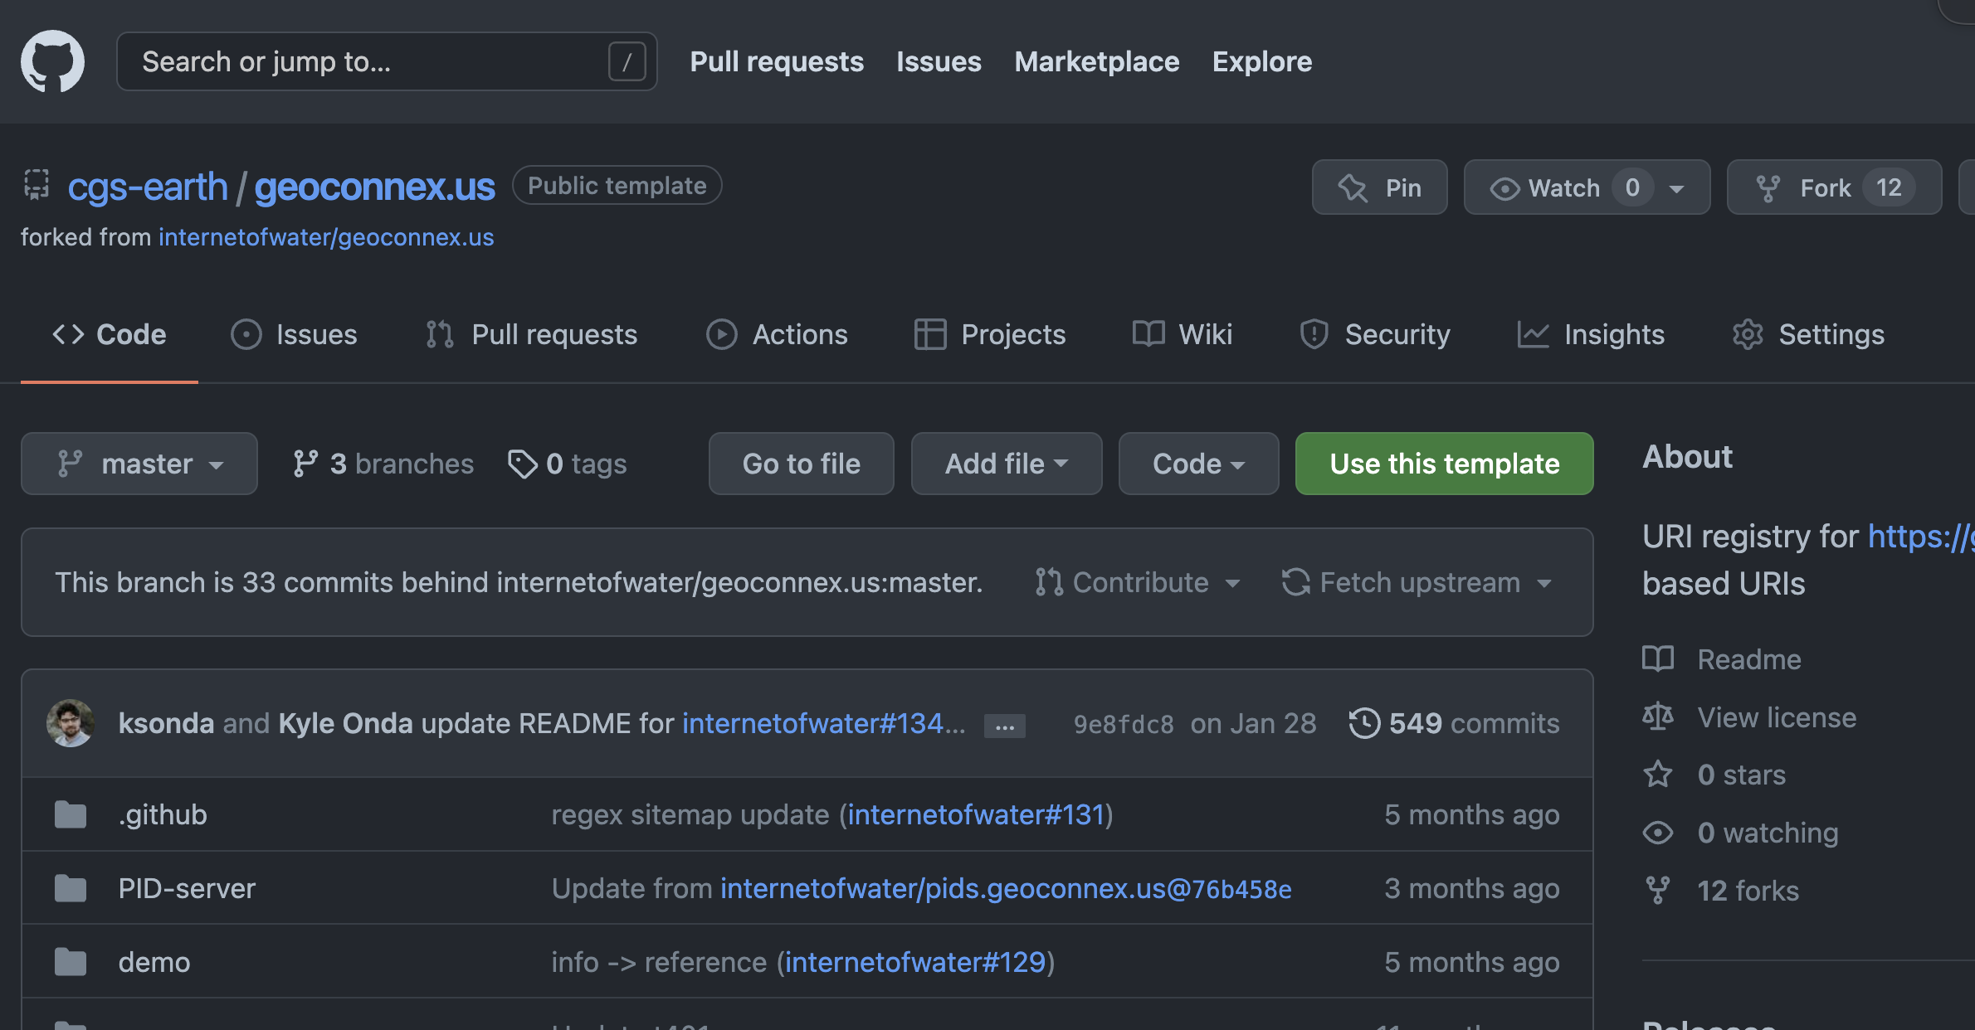
3. Mint persistent identifiers with https://geoconnex.us
Step 1: Fork the repository: https://github.com/internetofwater/geoconnex.us

Slide 33
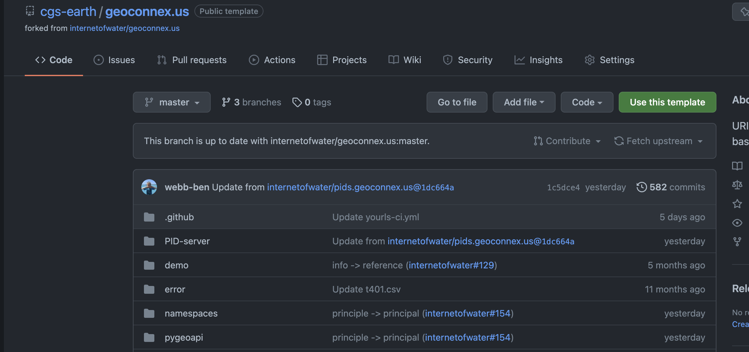
3. Mint persistent identifiers with https://geoconnex.us
Step 2: Add your own namespace

Slide 34
3. Mint persistent identifiers with https://geoconnex.us
Step 2: Add your own namespace

Slide 35
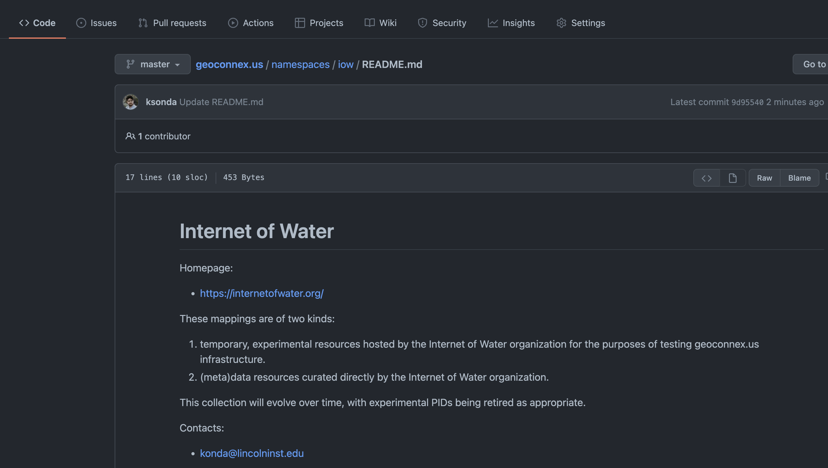
3. Mint persistent identifiers with https://geoconnex.us
Step 2: Add your own namespace (and make a descriptive README)

Slide 36
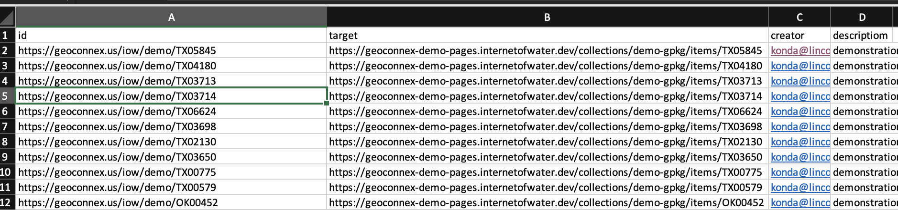
3. Mint persistent identifiers with https://geoconnex.us
Step 3: Create a csv in the following format
The persistent ID for each feature
The URL for the landing page you want the ID to redirect to

Slide 37
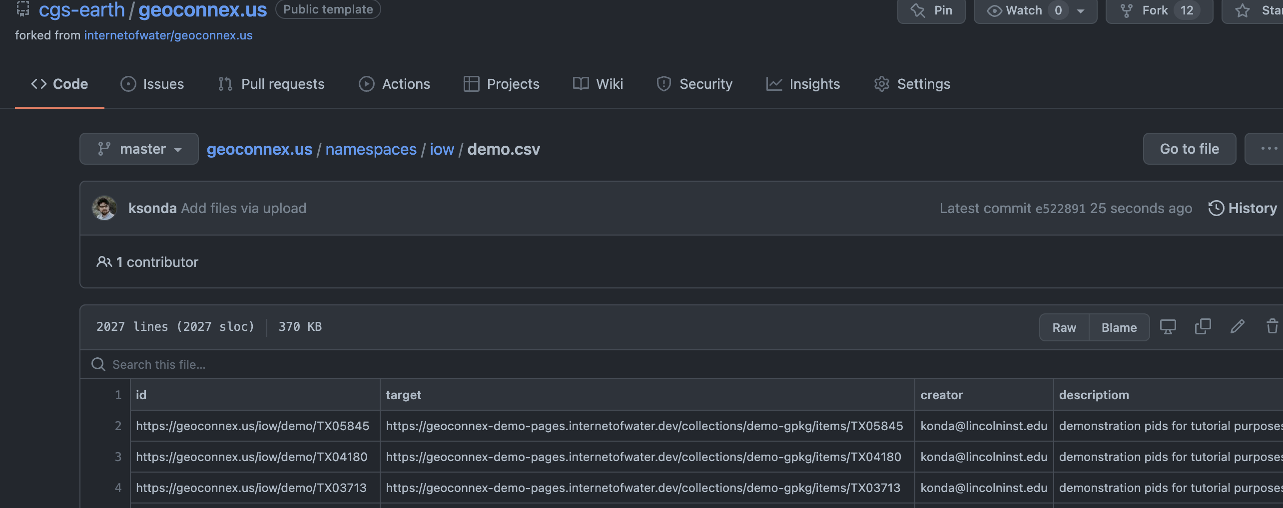
3. Mint persistent identifiers with https://geoconnex.us
Step 4: Add the csv to your namespace folder

Slide 38
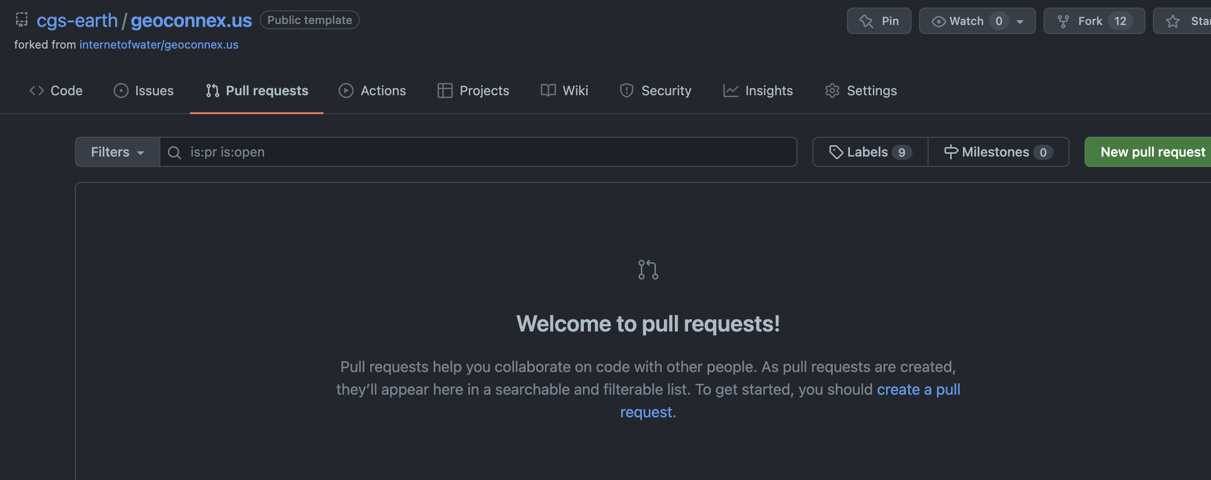
3. Mint persistent identifiers with https://geoconnex.us
Step 5: Open a pull request to the main repository

Slide 39
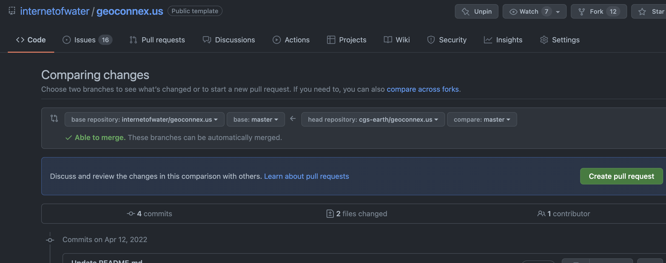
3. Mint persistent identifiers with https://geoconnex.us
Step 5: Open a pull request to the main repository

Slide 40
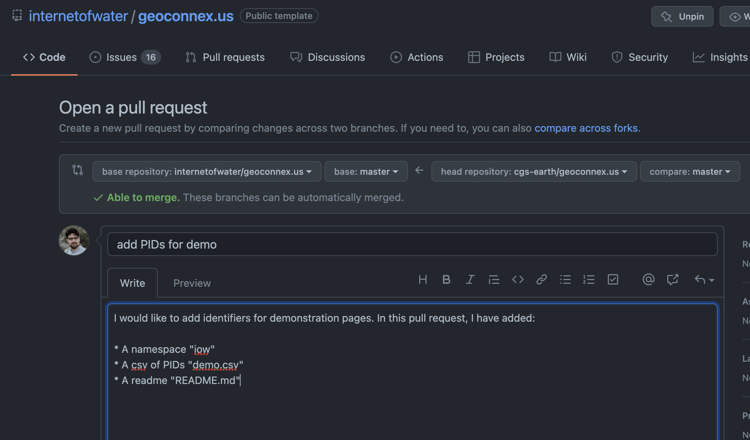
3. Mint persistent identifiers with https://geoconnex.us
Step 5: Open a pull request to the main repository

Slide 41
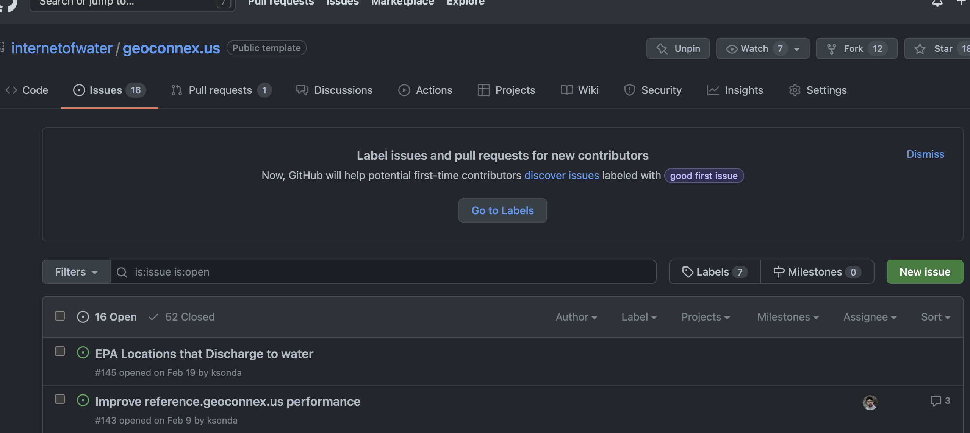
3. Mint persistent identifiers with https://geoconnex.us
Step 6: Wait for your pull request to be approved
Alternative to Steps 1-6: Open an Issue and ask the geoconnex.us team to help you directly!

Slide 42
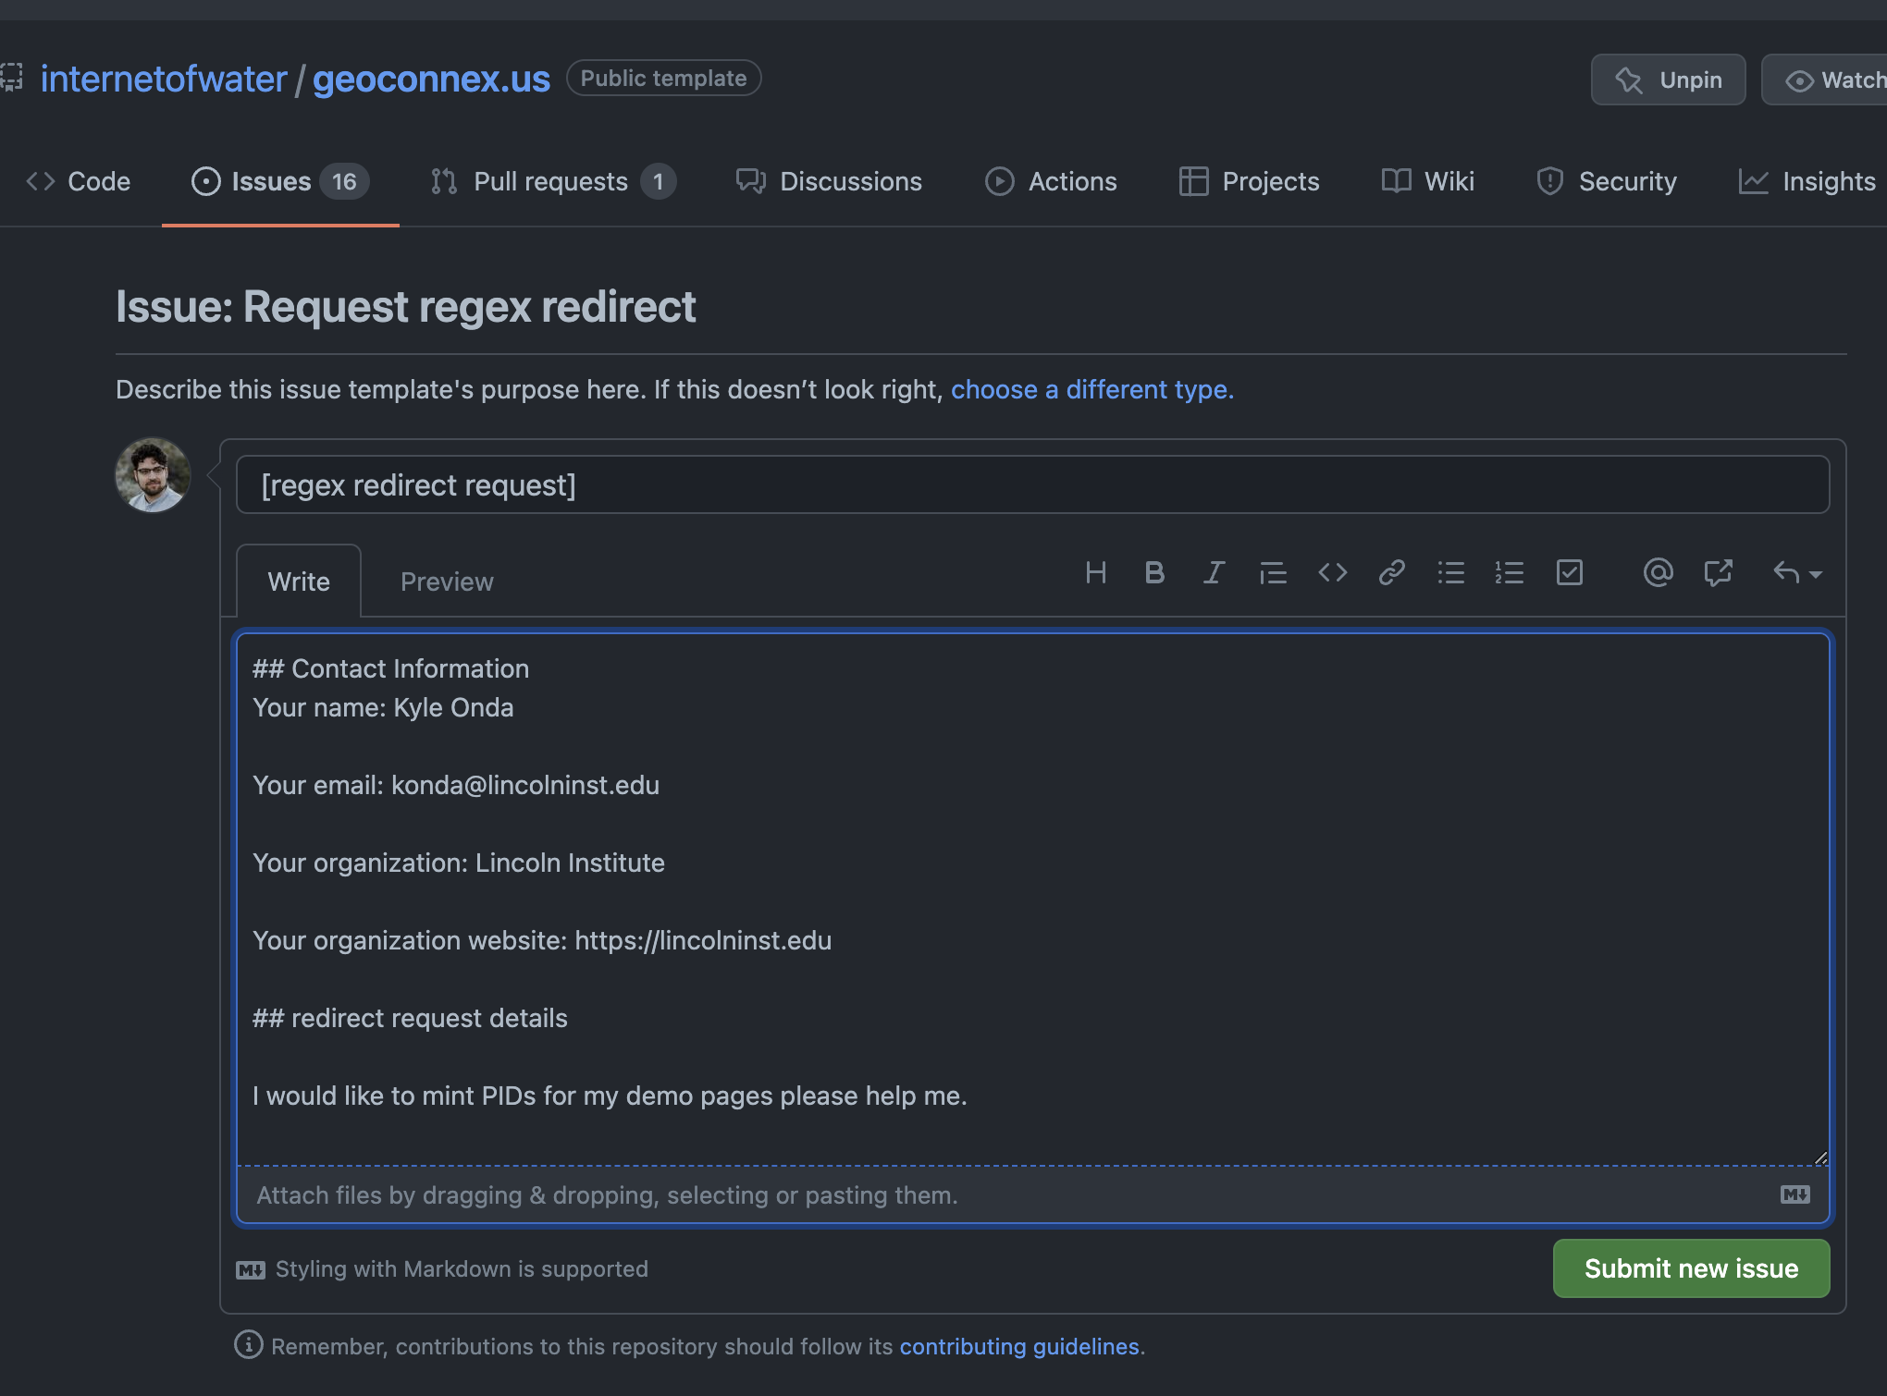
3. Mint persistent identifiers with https://geoconnex.us
Step 6: Wait for your pull request to be approved
Alternative to Steps 1-6: Open an Issue and ask the geoconnex.us team to help you directly!

Slide 43
3. Mint persistent identifiers with https://geoconnex.us
Step 7: Try your PIDs!
https://geoconnex.us/iow/demo/TX05845

Slide 44
Now let’s contribute data to the NLDI

Slide 45
4. Publish a geojson file with your hydro-addressed location data
The NLDI requires a geojson (POINT geometry) file accessible from a URL (API or data repository) with at least columns that include the following concepts
id: a unique alphanumeric identifier for the feature within the file
uri: url pointing to a particular feature web resource where more information can be found (this can be a geoconnex PID)
name: name for the feature
Reach (optional): the NHD reachcode from the feature’s hydrologic address (NHDPlusV2 for now, NHDHR coming)
Measure (optional): the measure along the reachcode from the hydrologic address

Slide 46
4. Publish a geojson file with your hydro-addressed location data
Option 1: URL for GeoJSON output from a web service
NOTE: No pagination allowed (e.g., only <2,000 features for ESRI FeatureServer)
NOTE: Ensure output is in WGS84 CRS
NOTE: Endpoint must be publicly available (no authentication)
Examples:
ESRI Feature Service: https://services5.arcgis.com/9b85MAhVnAUWydgW/ArcGIS/rest/services/data/FeatureServer/0/query?where=1%3D1&outFields=*&outSR=4326&f=pgeojson
Pygeoapi (same as internet of water landing page generator):
https://geoconnex-demo-pages.internetofwater.dev/collections/demo-gpkg/items?f=json&limit=10000

Slide 47
4. Publish a geojson file with your hydro-addressed location data
Option 2 (>2,000 features or so): Create a separate geojson file with the fields, and place at a publicly available location with a http(s) URL (NO AUTHENTICATION). Examples:
CUAHSI Hydroshare
University dataverse
USGS ScienceBase
Personal website
Github (if < 100MB)
ESRI ArcGIS Online ”Content” :
https://lincolninstitute.maps.arcgis.com/home/item.html?id=89f9aa64d7ff47dd8bd2548385f3bc02
https://lincolninstitute.maps.arcgis.com/sharing/rest/content/items/89f9aa64d7ff47dd8bd2548385f3bc02/data

Slide 48
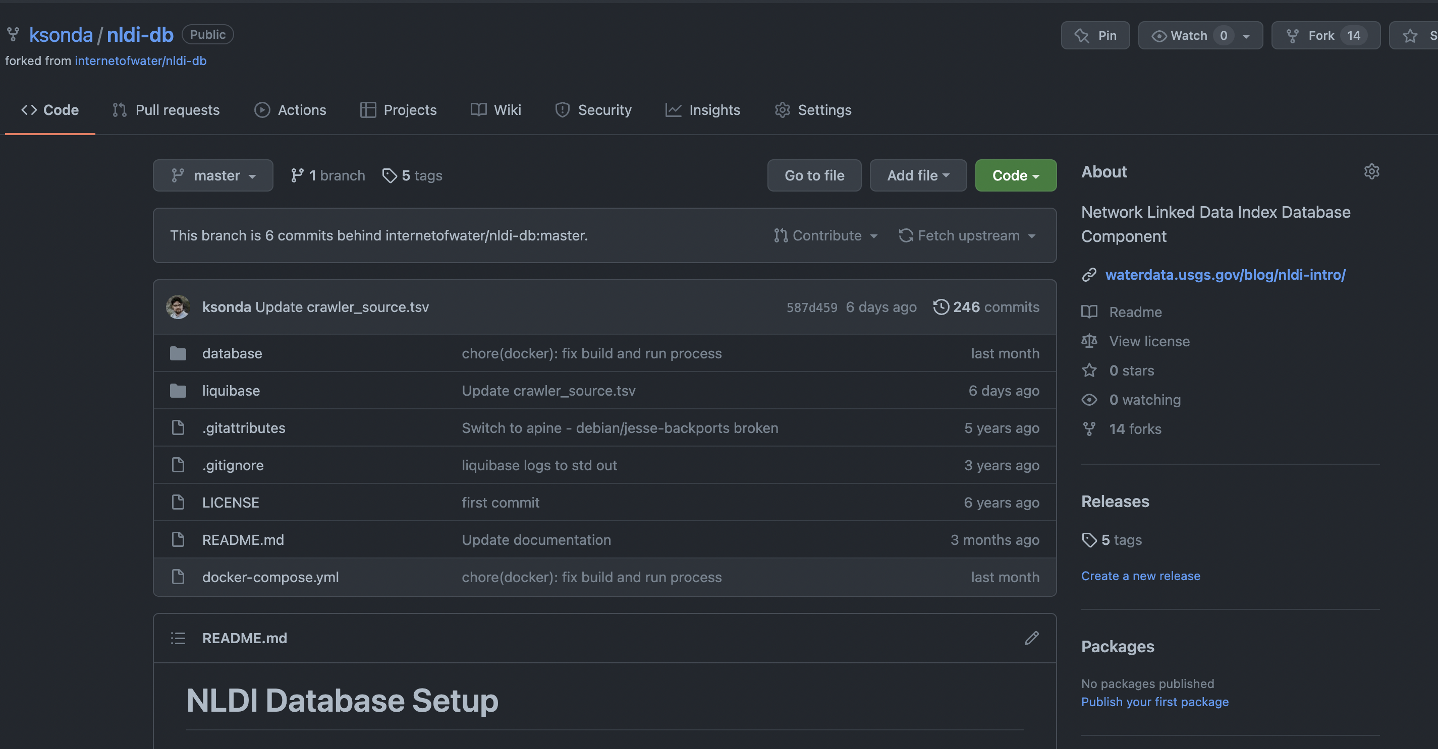
5. Register your geojson file with the NLDI repository
Step 1: Fork github repository:
https://github.com/internetofwater/nldi-db

Slide 49
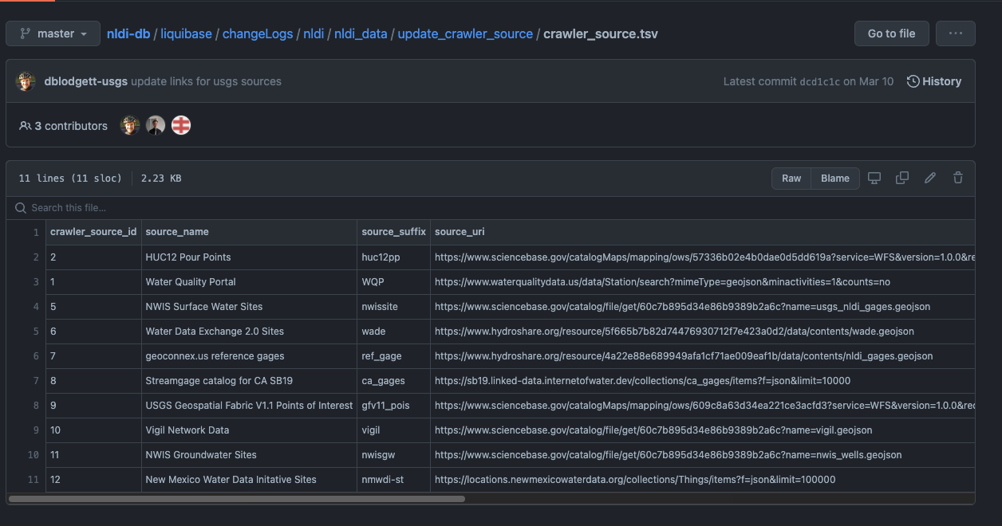
5. Register your geojson file with the NLDI repository
Step 2: Update NLDI dataset registry:

Slide 50
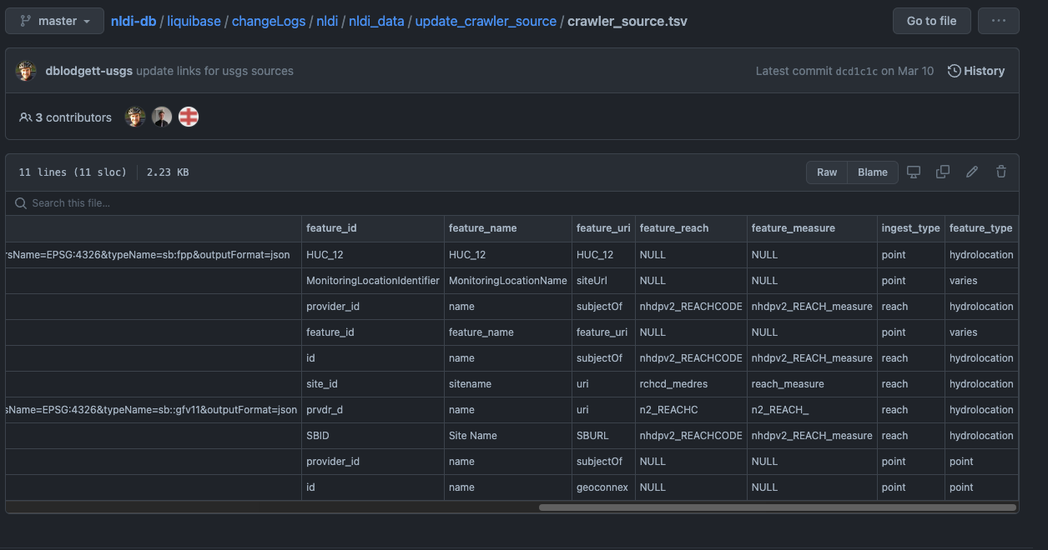
5. Register your geojson file with the NLDI repository
Step 2: Update NLDI dataset registry, map geojson attributes to registry fields:

Slide 51
5. Register your geojson file with the NLDI repository
Step 2: Update NLDI dataset registry, map geojson attributes to registry fields:
https://github.com/ksonda/nldi-db/commit/0b36df17a67a71d3c490e2ab5408d0a4fcf5f65c#diff-7dce4ef6fadf7baa6c6a3309d25413215e43b79cd7795d63c972da88096adc5e

Slide 52
5. Register your geojson file with the NLDI repository
Step 3: Open Pull Request with your contribution
https://github.com/ksonda/nldi-db/commit/0b36df17a67a71d3c490e2ab5408d0a4fcf5f65c#diff-7dce4ef6fadf7baa6c6a3309d25413215e43b79cd7795d63c972da88096adc5e

Slide 53
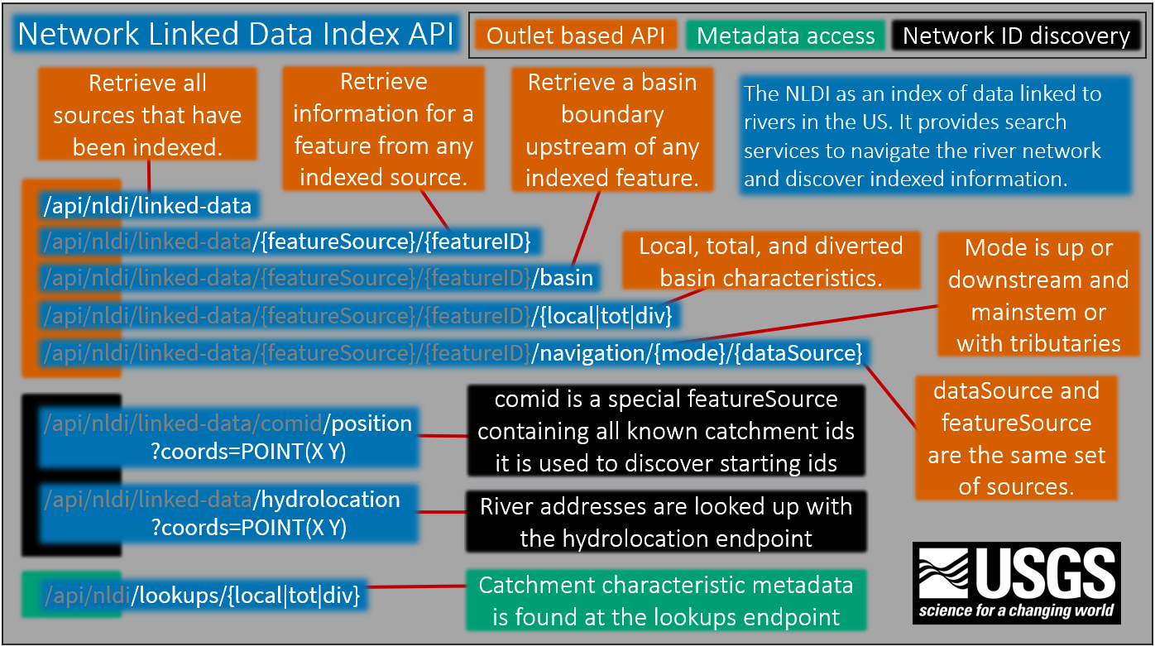
Leverage the NLDI:
Swagger docs:
https://labs.waterdata.usgs.gov/api/nldi/swagger-ui/index.html

Slide 54




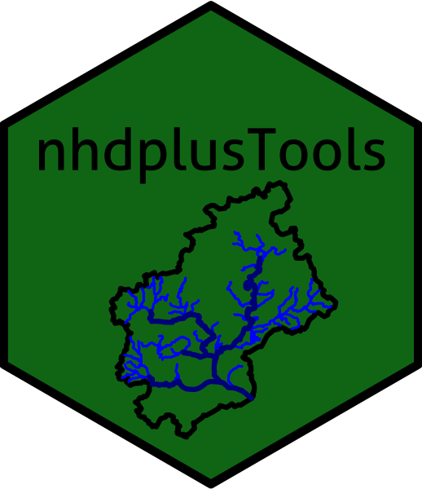

NLDI – How to use (ESRI ArcGIS Online Demo)
GET requests to URLs ->
Receive GeoJSON ->
Use in analysis, GIS software, custom web applications

Slide 55
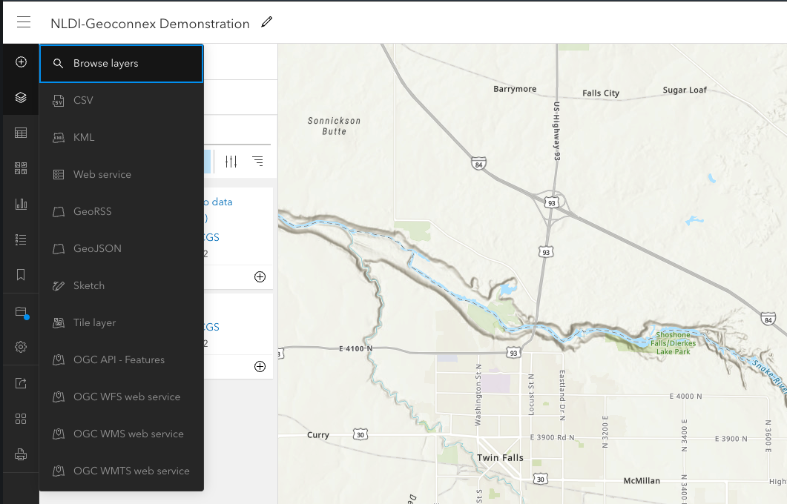
NLDI – How to use (ESRI ArcGIS Online Demo)
GET requests to URLs ->
Receive GeoJSON ->
Use in analysis, GIS software, custom web application

Slide 56
NLDI – How to use (ESRI ArcGIS Online Demo)
GET requests to URLs ->
Receive GeoJSON ->
Use in analysis, GIS software, custom web application

Slide 57
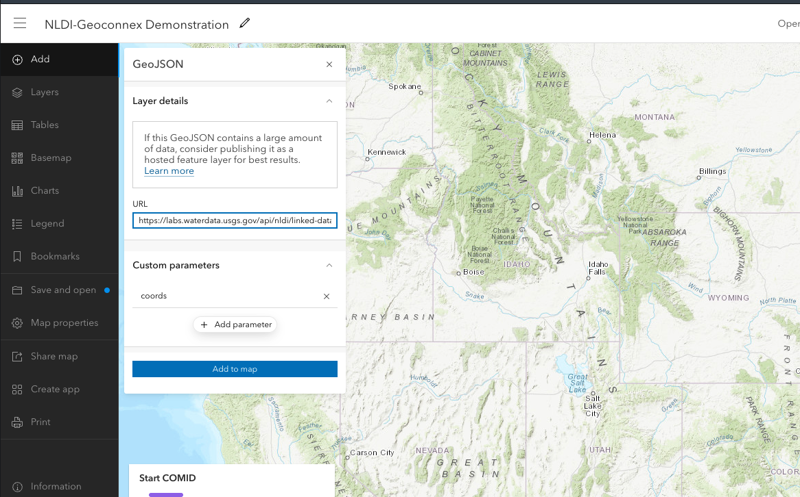
NLDI – How to use (ESRI ArcGIS Online Demo)
GET requests to URLs ->
Receive GeoJSON ->
Use in analysis, GIS software, custom web application

Slide 58
https://storymaps.arcgis.com/stories/0ecb1aaf143b4e1981dbe30f38fceec5

Slide 59
Thank you
Reach out for help by submitting an issue to
https://github.com/internetofwater/geoconnex.us
Or email: konda@lincolninst.edu

